Slide 1
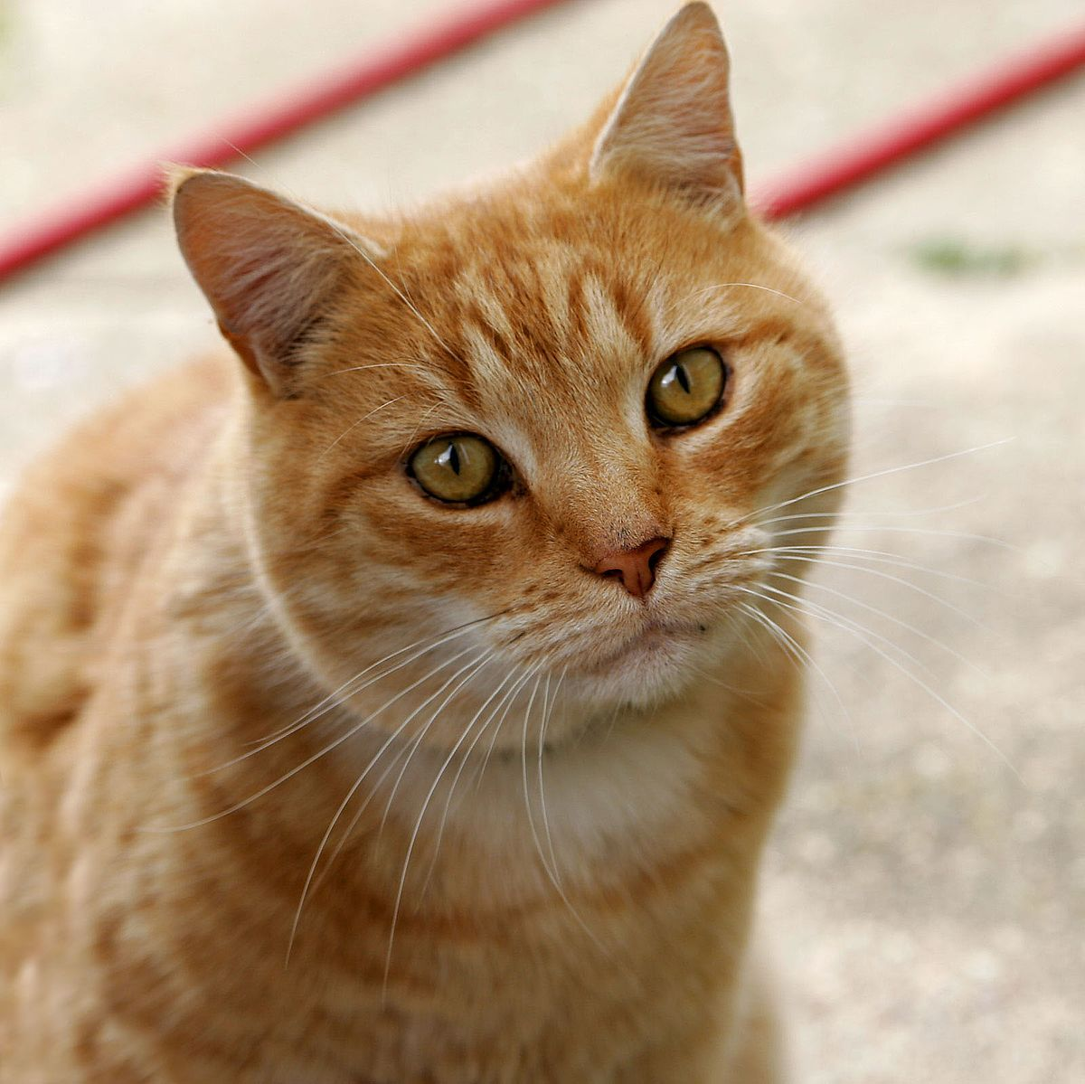
Cat
The cat is a domestic species of small carnivorous mammal.
It is the only domesticated species in the family Felidae.

Slide 2
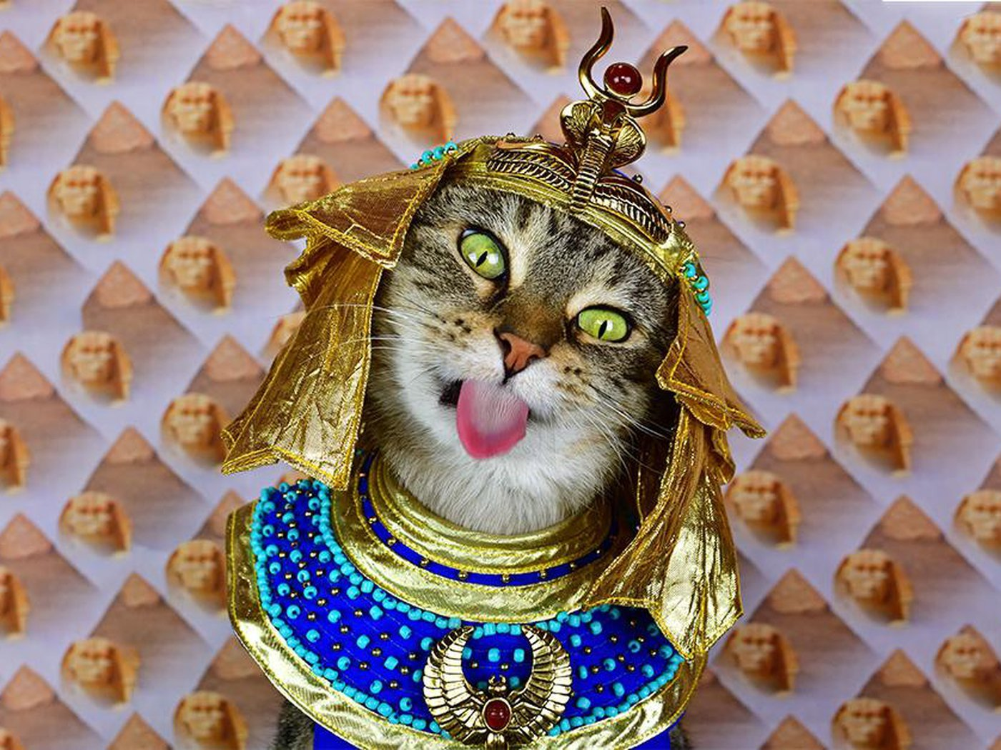
Etymology and naming
The origin of the word cat is thought to be the Late Latin word cattus, which was first used at the beginning of the 6th century.

Slide 3
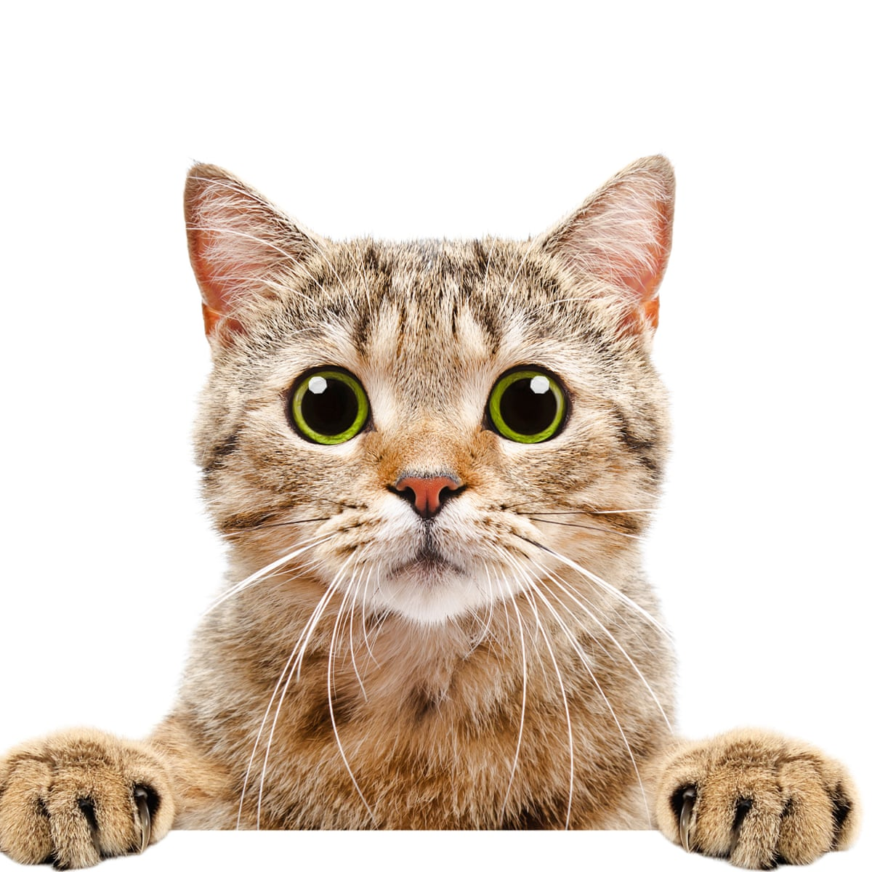
Taxonomy
The scientific name Felis catus was proposed by Carl Linnaeus in 1758.

Slide 4
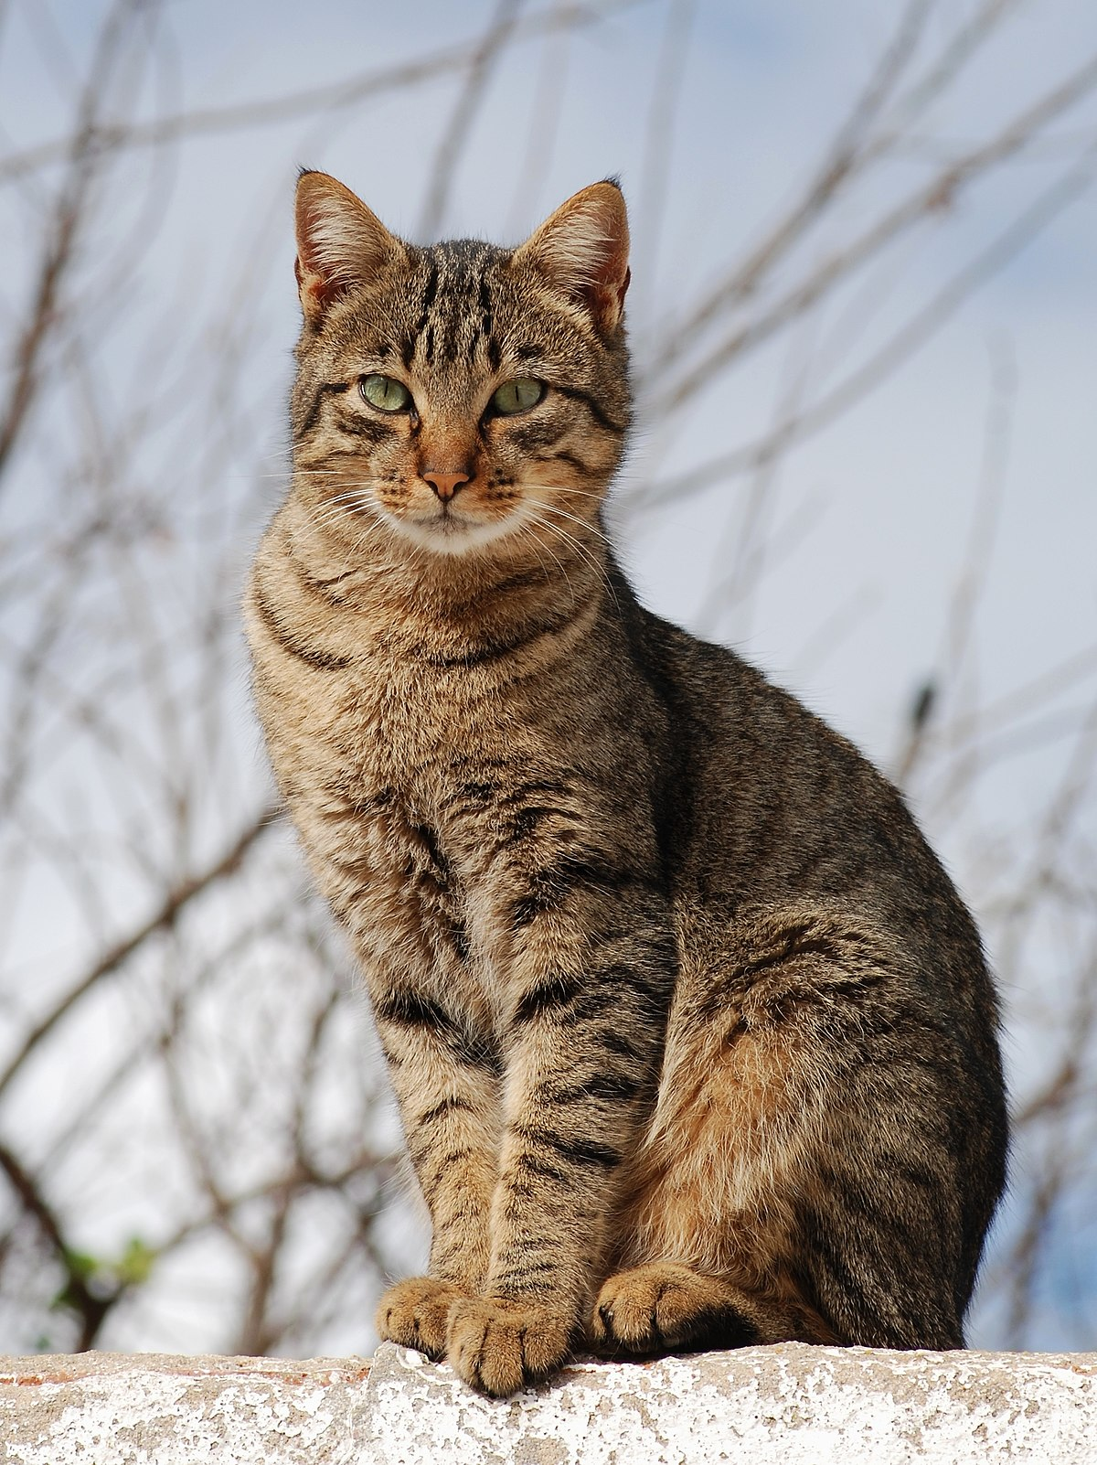
Evolution
The domestic cat is a member of the Felidae.
The genus Felis diverged from other Felidae around 6–7 million years ago.

Slide 5
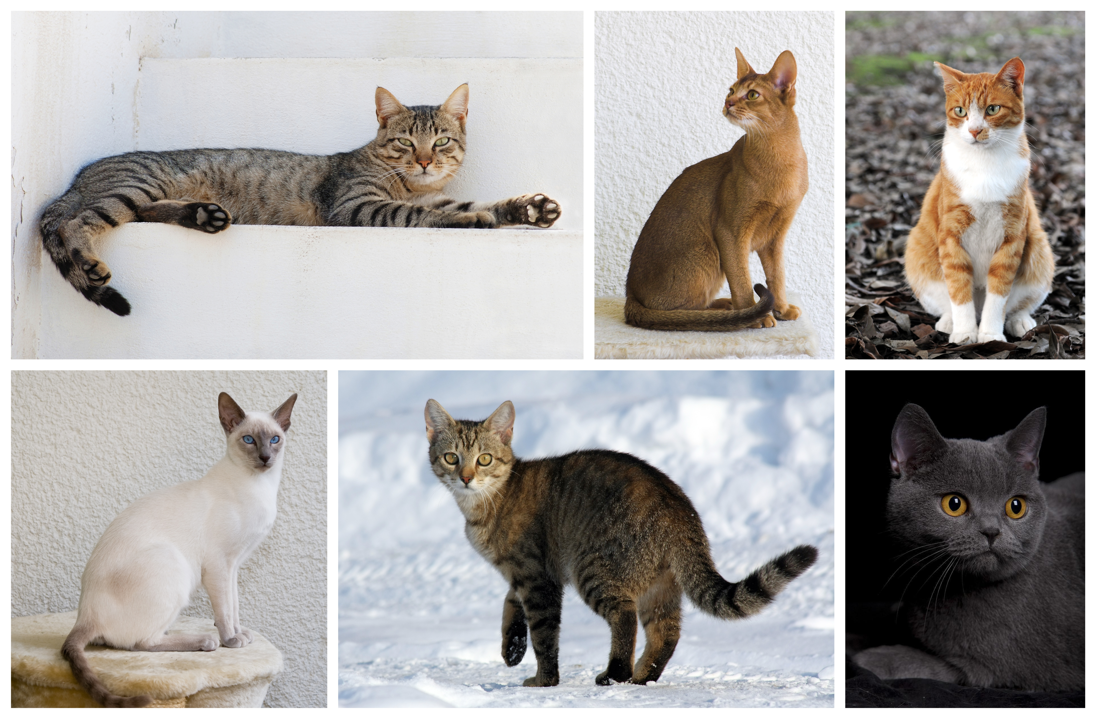
Characteristics

Slide 6
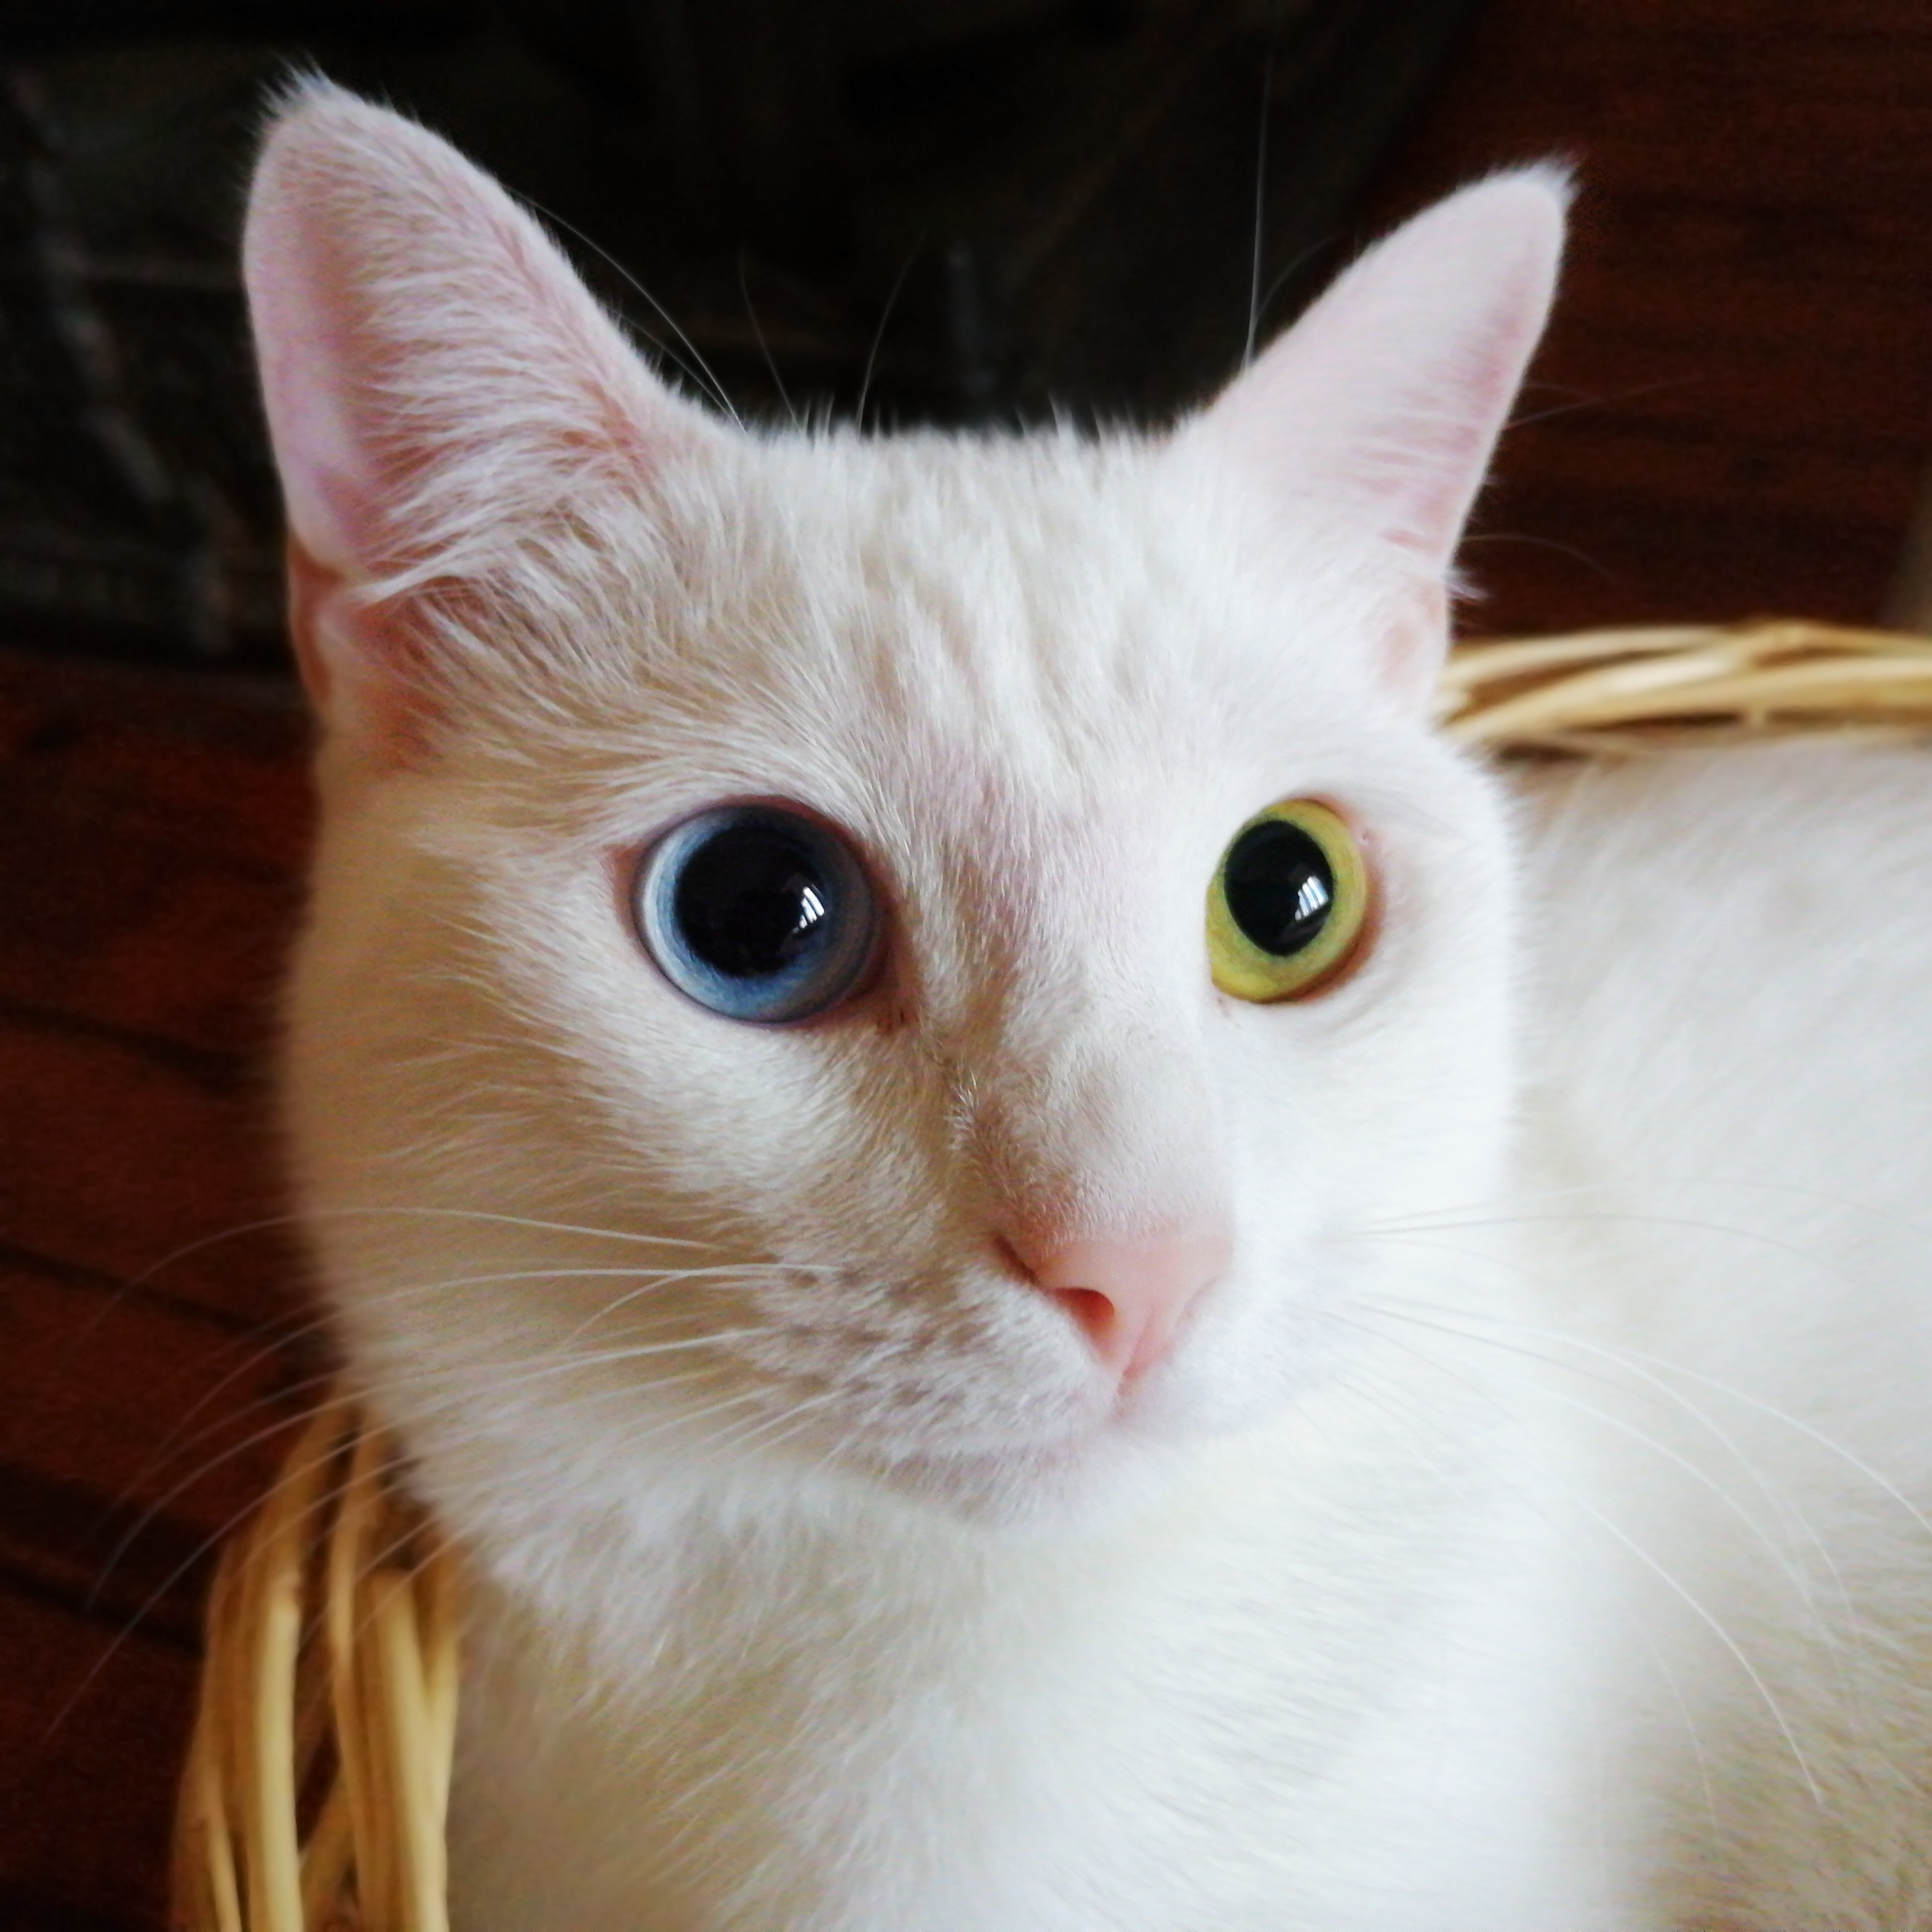
Senses

Slide 7
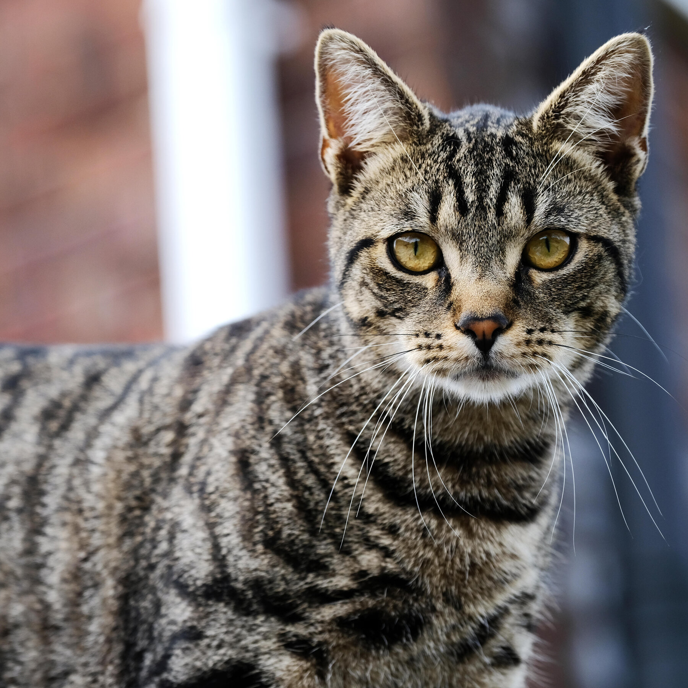
Behavior
Outdoor cats are active both day and night.
They tend to be more active at night.

Slide 8
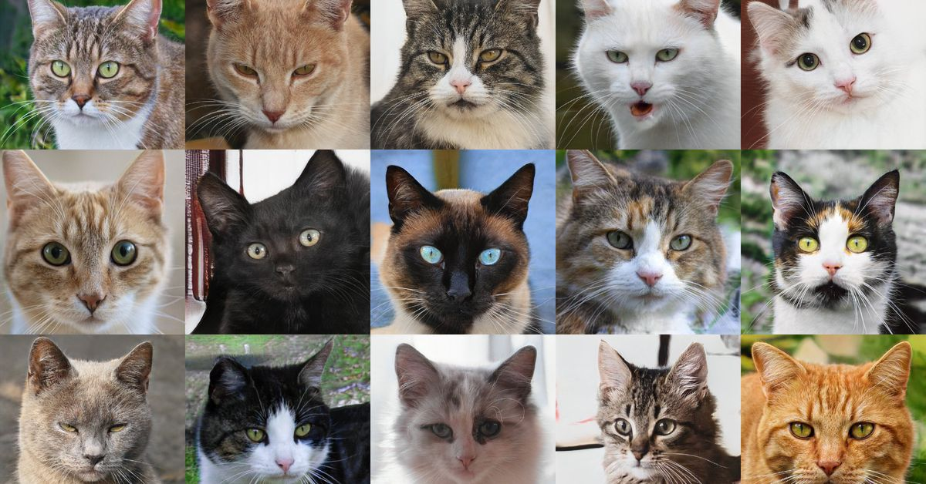
Lifespan and health
The average lifespan of pet cats has risen in recent decades.
In the early 1980s, it was about seven years, rising to 9.
4 years in 1995 and 15.

Slide 9
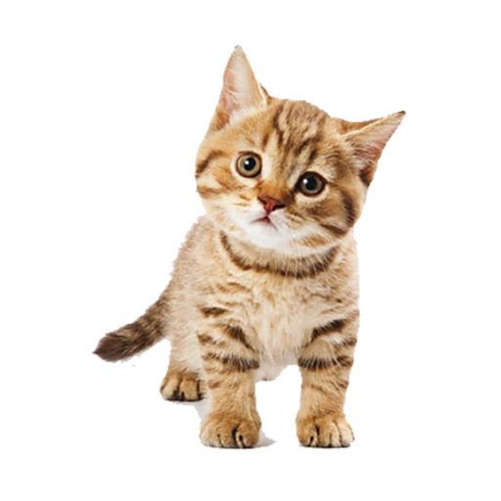
Ecology

Slide 10
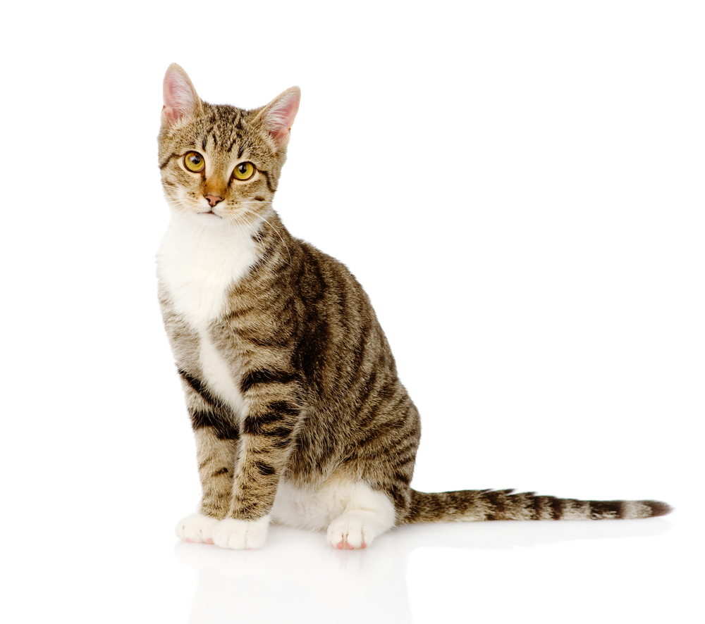
Interaction with humans
re common pets throughout the world.
Cats have been used for millennia to control rodents, notably around grain stores and aboard ships.

